Slide 1


Sleep Deprivation Classification using BOLD fMRI Data
CSML1030 Capstone Project

Slide 2


PROJECT PARTNER
Working with the Krembil Centre for Neuroinformatics at CAMH, the Centre for Addiction and Mental Health
Dr. Erin Dickie, Scientist and Assistant Professor, Krembil Centre for Neuroinformatics, CAMH
David Rotenberg, Operations Director, Krembil Centre for Neuroinformatics, CAMH
Various projects available – goal in selecting a problem and dataset was to provide both useful academic conclusions to the CAMH scientists and to provide a challenging and educational project to the team

Slide 3
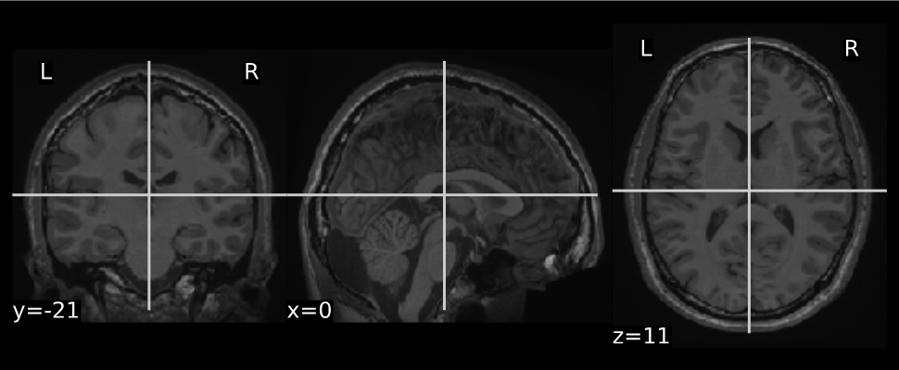
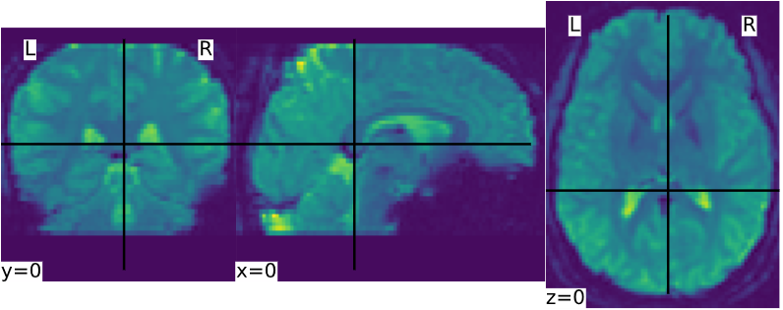
What is BOLD MRI Imaging?
Blood Oxygen Level Dependent functional Magnetic Resonance Imaging
Uses oxygenation of blood flow in the brain to give contrast to images.
Allows us to pinpoint areas of neurological activity – neurons need oxygen to fire
Lots of noise in the signal, BOLD activity is relative to other less-active parts of the brain, not absolute
Anatomy Image
BOLD Image

Slide 4

SOURCE DATA
The Stockholm Sleepy Brain Study: Effects of Sleep Deprivation on Cognitive and Emotional Processing in Young and Old
Available from OpenNeuro neuroinformatics database under creative commons CCO license (public domain)
Chosen to align with Dr. Dickie’s interest in identifying whether there are visible changes in the brain (and in the fMRI images) when a subject is sleep deprived vs not sleep deprived

Slide 5

MACHINE LEARNING APPLICATION
Use Machine Learning techniques to explore the BOLD fMRI data and to build a classifier based on the sleep deprivation metadata for each subject
Success or failure of this classifier will help quantify whether identifiable changes exist in the brain (or at least in the BOLD fMRI images) when a subject is sleep deprived
Insights can be applied to broader work at CAMH involving the correlation of sleep quality/disruption with mental illness

Slide 6
PROBLEM STATEMENT
Identify sleep deprivation/sleep states and whether these changes can be identified using focused feature engineering and machine learning modelling
Develop a binary classifier that identifies whether a subject is sleep deprived or not based on the BOLD fMRI scans.
a. Pre-process/clean the data and engineer any necessary features to support this.
b. Run both traditional and deep learning machine learning algorithms and choose the best classifier based on specific scoring metrics.
2. Engineer frequency-domain features via a Fourier transform on the time series of BOLD fMRI scans. Develop and assess a binary classifier using these features to determine whether certain specific frequencies (noted in the “BOLD signatures of sleep” paper) correlate with different sleep states.

Slide 7
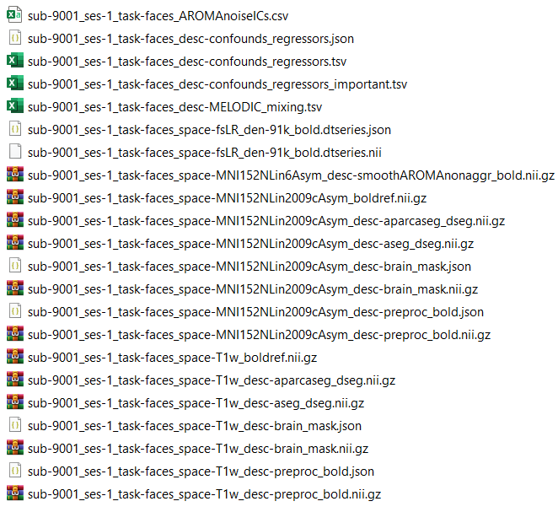
THE DATASET
BOLD fMRI imaging data for 86 subjects
Each subject performs 5 tasks > BOLD MRI image for each one
Imaged over two sessions
Session a) Subject had a normal night’s sleep
Session b) Subject was sleep deprived (only 3 hours of sleep)
Total: 86 subjects x 5 tasks x 2 sessions = 860 BOLD MRI image files

Slide 8
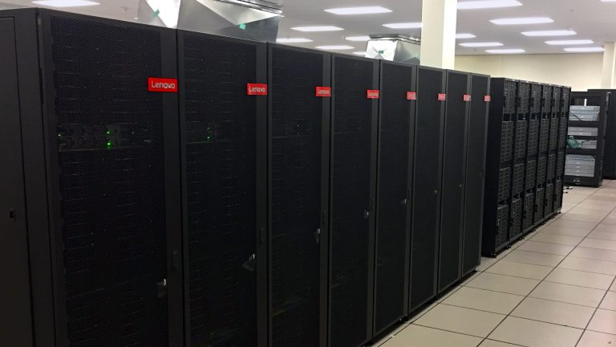
PREPROCESSING
Dataset required complex pre-processing
Dr. Dickie ran this on the Niagara Cluster, most powerful academic supercomputing cluster in Canada
Pre-processing involved spatial normalization of BOLD images to MNI (Montreal Neurological Institute) template
Standardizing shape and position of brains so that an x/y/z position in one scan is comparable to another
Confound signals extracted and initial mask files generated
The Niagara Cluster
2016 nodes
80,640 cores at 2.5 or 2.4 GHz
6 petaflops of processing power
Handles hundred terabyte datasets

Slide 9
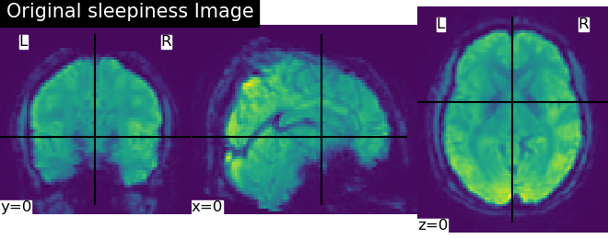
THE BOLD FILES
Ranging from 150 MB to 450 MB per BOLD image.
Raw data should be about 989 GB in total.
4D files
x, y, z dimensions: physical space and resolution
Range of sizes (x: 87-104 y: 103-134 z: 65-81)
t dimension: time slice (static-MRI images taken at 3 second intervals)
Ranging 146 – 400 time slices

Slide 10

PYTHON RESOURCES
Using Ni-Learn and NiBabel packages
NifTi-format images (Neuroimaging Informatics Technology Initiative)
4D array-like representation with various header info
Various functions such as NiftiMasker used to clean, manipulate, transform and extract features
Powerful package but sparse documentation and no troubleshooting online

Slide 11
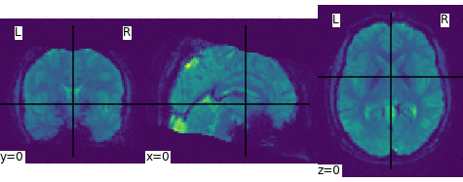
4D BOLD IMAGE
BOLD Image Visualized Over 100 Time Slices
(5 minutes)

Slide 13
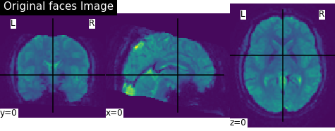
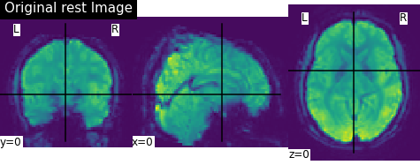
WHAT IS MASKING?
Parameters in which images were capture and shape of subject brains/images are all different
Of the 5 tasks, 2 tasks have a significantly cut-down “viewport”.

Slide 14
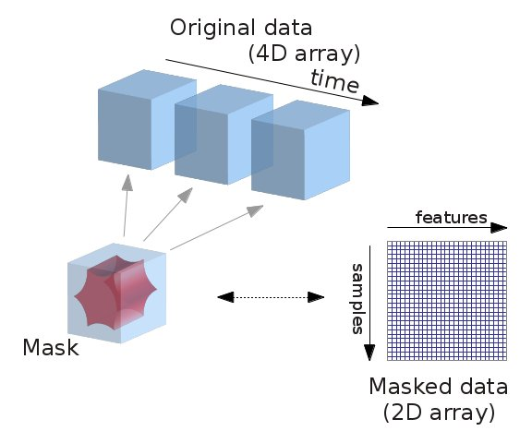
MASKING
These differences are not acceptable for an ML model – need to compare Apples to Apples
Solution: masking and mask intersection
Mask: A 3d true/false matrix that tells a Masker where to ‘crop’ the image at all points in space and over time
Resample images to uniform shape and affine (orientation/transformation matrix)
Calculate intersection of all 860 masks to get final comparable result

Slide 15
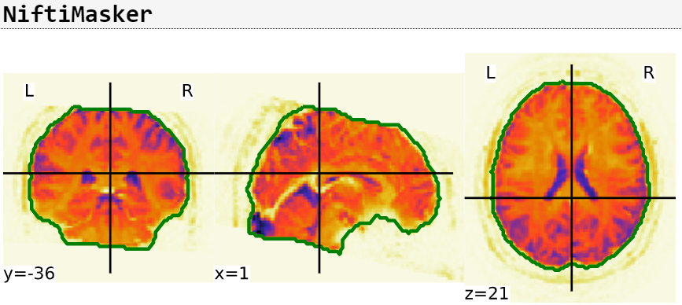
MASKING APPLICATION
Calculated 3D mask visualized on a plane
(Faces Task)

Slide 16
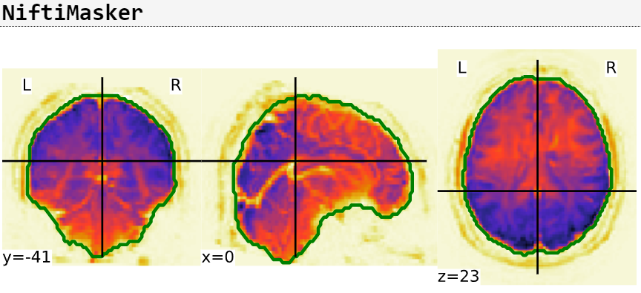
MASKING APPLICATION
Calculated 3D mask visualized on a plane
(Sleepiness Task)

Slide 17
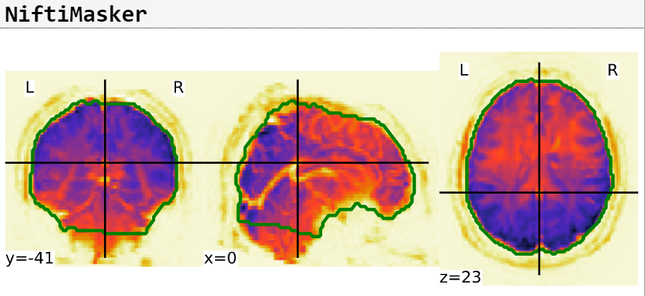
MASKING APPLICATION
Intersected 3D mask visualized on a plane
(Subject 9001 – Session 1)

Slide 18

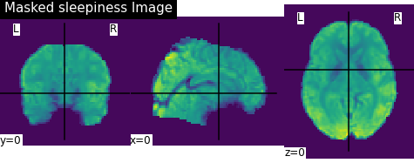
INTERSECT
MASK

Slide 19
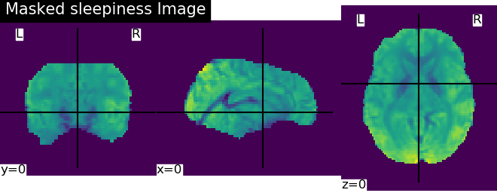
FINAL
MASK

Slide 20
FEATURE EXTRACTION
Niftimasker in Nilearn was used for feature extraction of some of the features.
Niftimasker applies data transformation on nifti images and converts them into a 2D array
To pass the features into ML models, we further flatten the array to 1D using ravel
The resulting feature set is then collected in a DataFrame to be passed into the ML models
#Loading the masker file to apply to images
masker = NiftiMasker(mask_img=configs.maskDataFile, standardize=False)
#Applying mask and flattening
masked_array = masker.fit_transform(image.index_img(filepath, slice(start,end)))
reshaped_array = np.reshape(masked_array.ravel(), newshape=[1,-1])

Slide 21
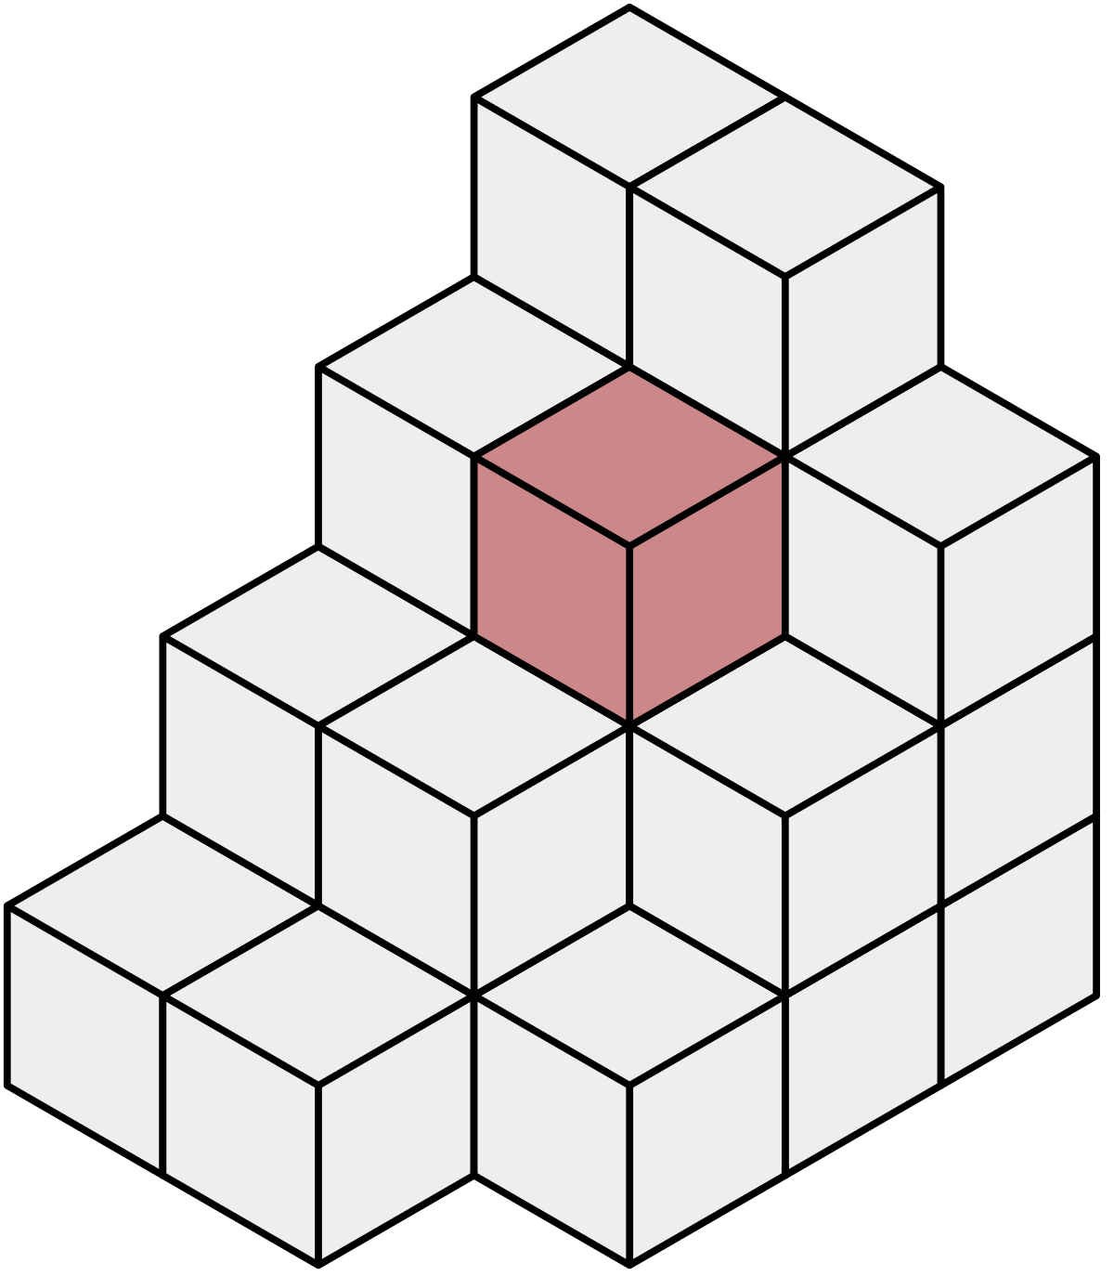
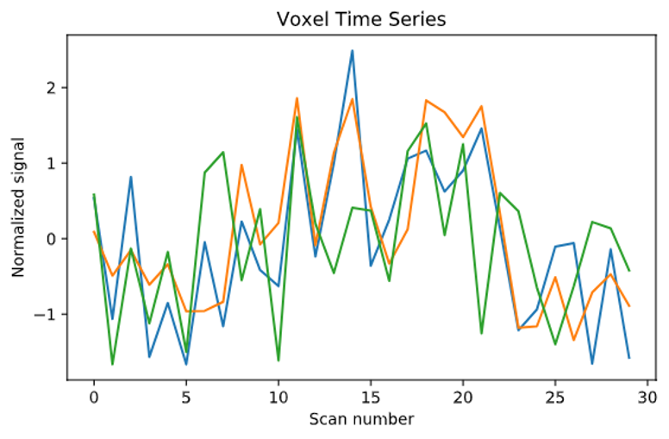
FEATURE EXTRACTION
Raw voxel data from NiftiMasker combinations:
Standardized = True/False
Confounds as noise filtering or not
Confounds as features or not
60 continuous time slices were isolated
Raw Voxel Data
Fun Fact: 45 GB of data was produced for each combination

Slide 22
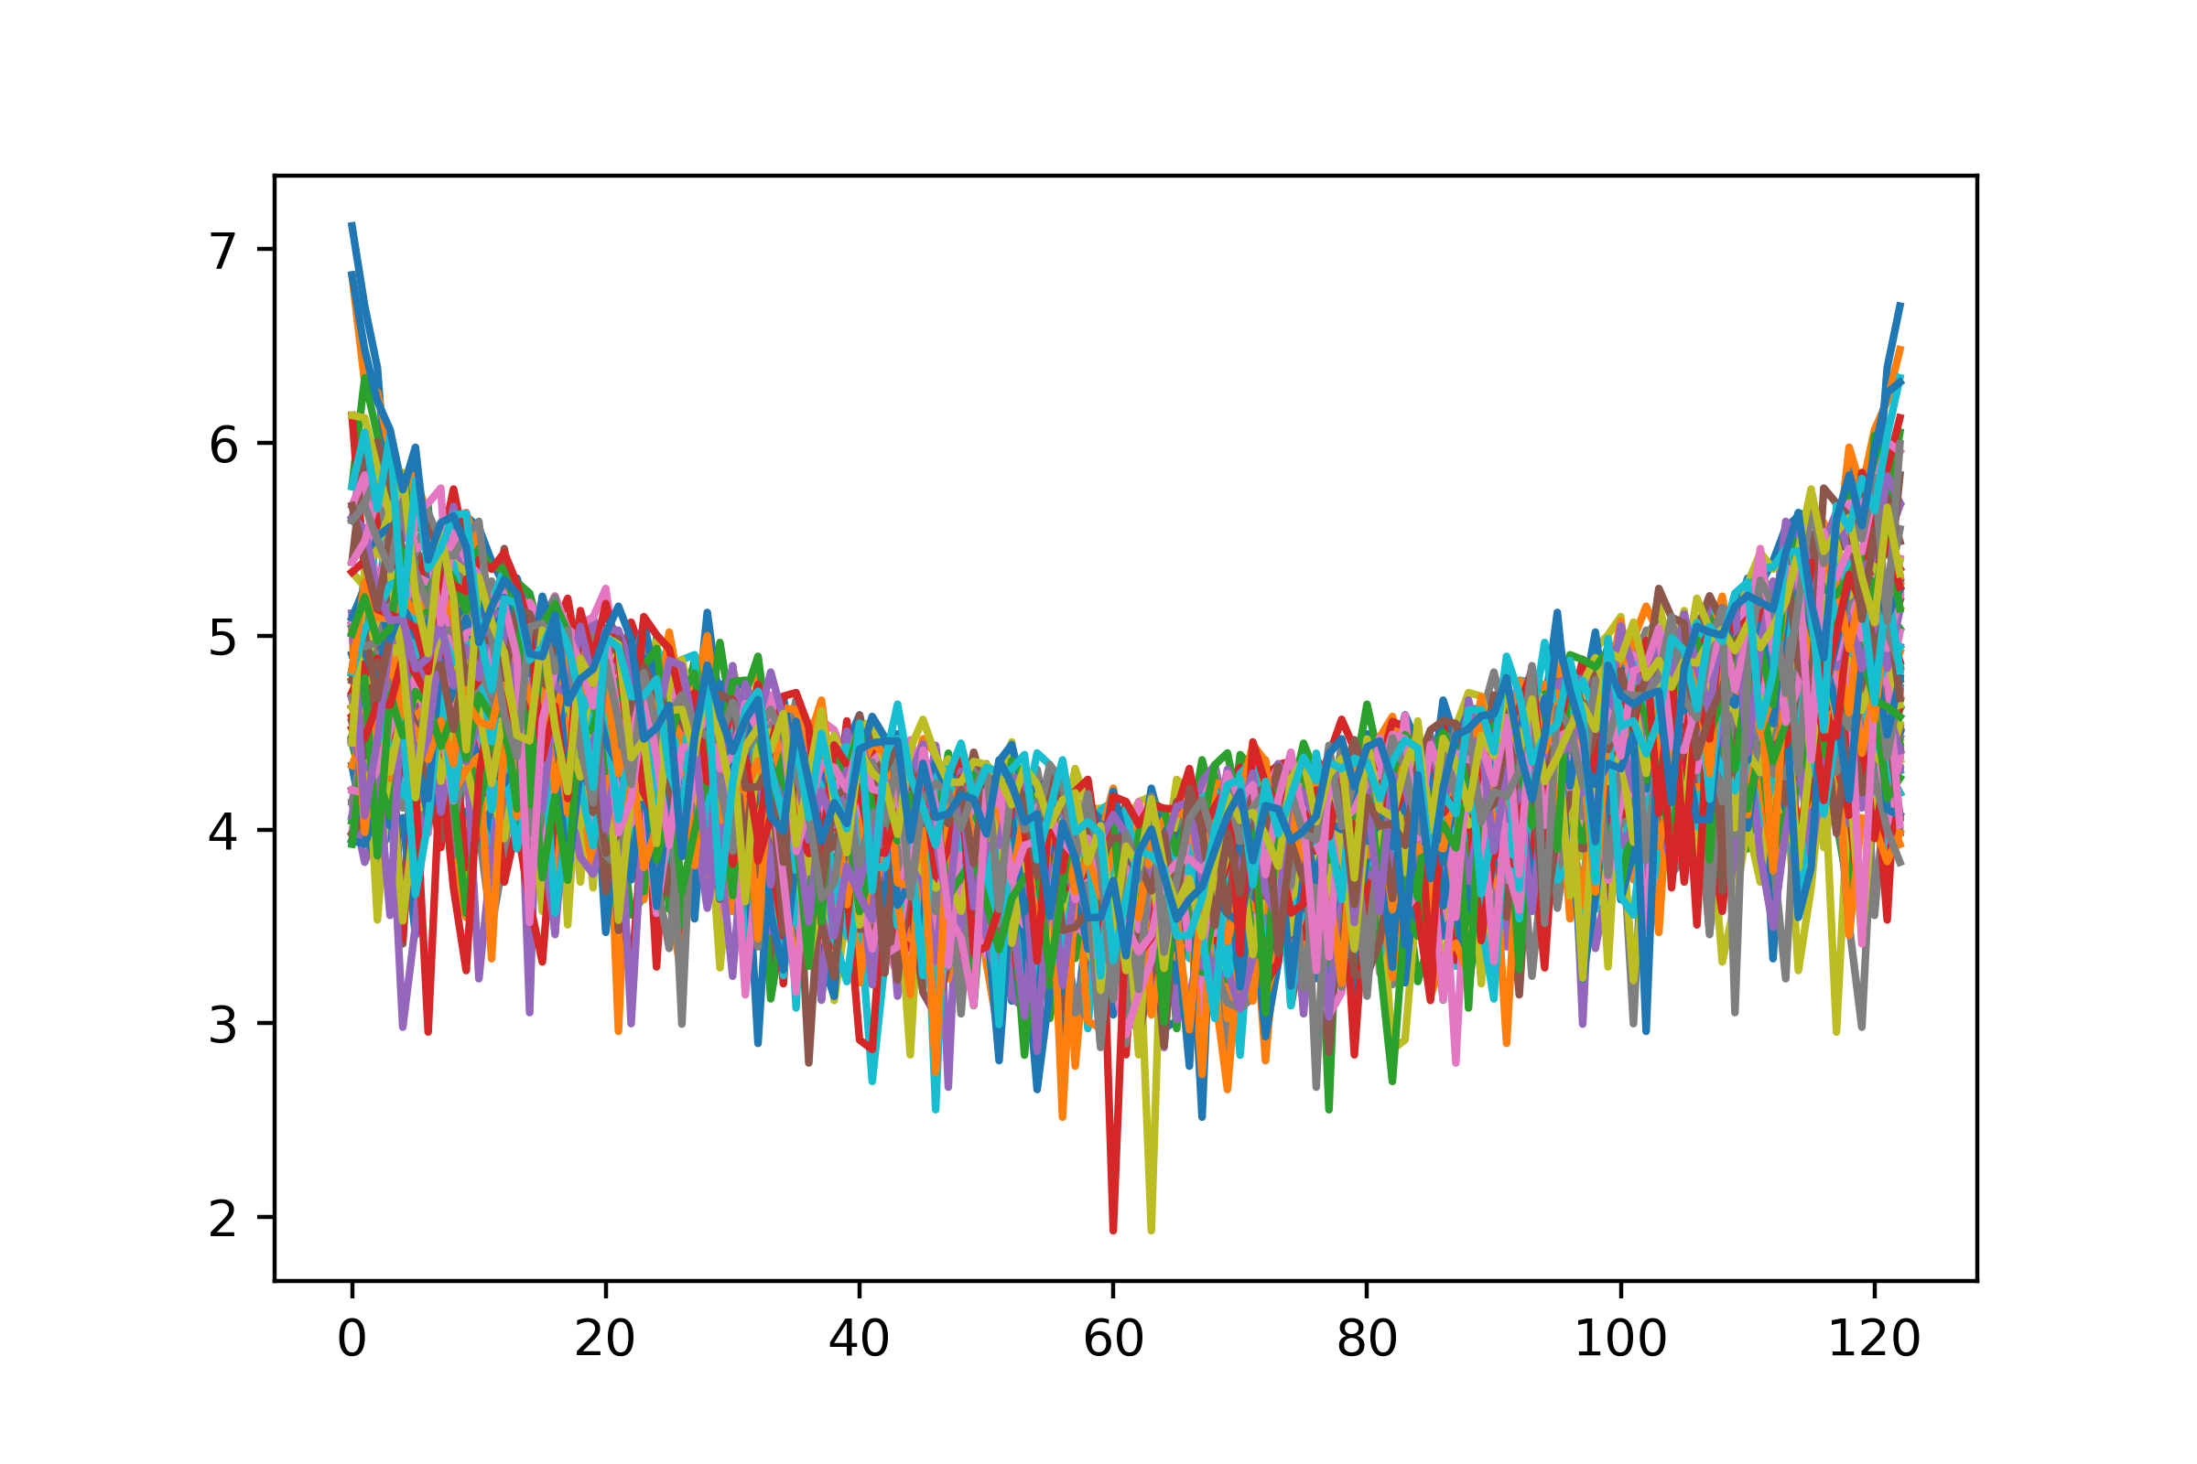
FEATURE EXTRACTION
Fast Fourier Transform
Fourier Transform
Iterate over 3-D images and do a 3-D FFT for each time slice/index
Iterate over 4-D image and do a 4-D FFT over the whole thing (ended up being the same size as 3-D, because math)
Fun Fact: With only 10 time slices there are 28 Billion data points in the feature array

Slide 23
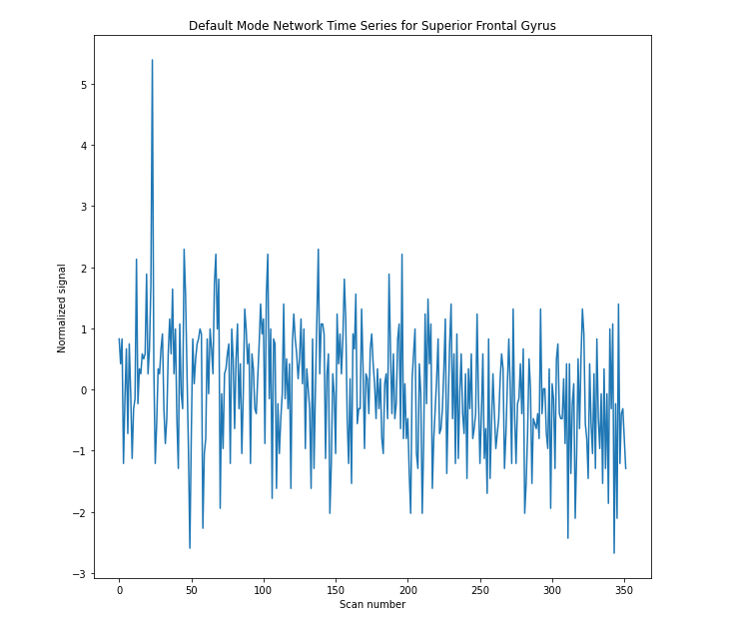
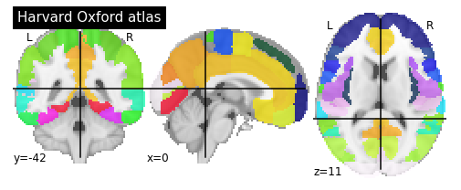
FEATURE EXTRACTION
Functional Connectivity (Part 1)
Extract Signals from ROI in Brain Parcellations:
Use the Harvard-Oxford Atlas to define ROI
Extract Signals from ROI

Slide 24
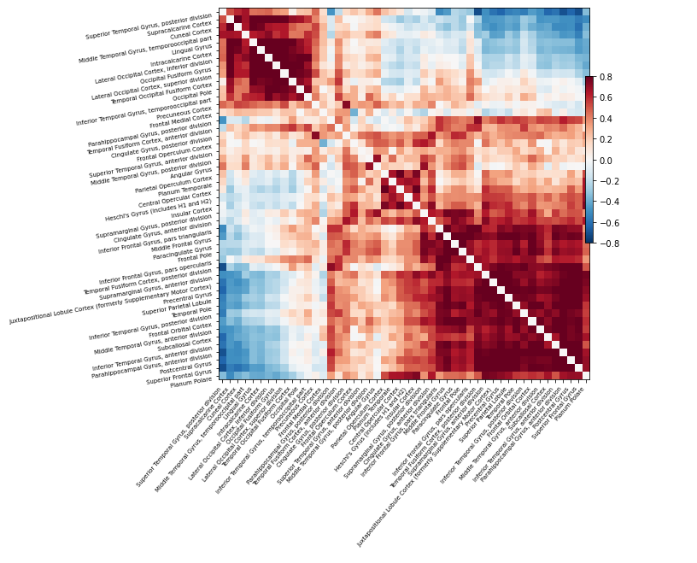
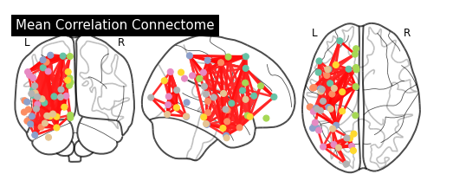
FEATURE EXTRACTION
Functional Connectivity (Part 2)
Compute functional connectivity between ROI:
Correlation, Partial Correlation, and Tangential

Slide 25
MODELS & PERFORMANCE
STANDARDIZE – In extracting features using nilearn, there is a way to standardize the input signal. Strategy to standardize the signal. ‘zscore’: the signal is z-scored. Timeseries are shifted to zero mean and scaled to unit variance. When set to 'True' the signal is z-scored
CONFOUNDS MASKING – Confounds in fMRI are the signals that are non-neuronal. These can be attributed to a subject's movements and other physiological changes during an MRI. We learnt from Dr. Dickie about the 36 confound variables usually used. There are 3 translational confounds, 3 rotational confounds, 3 global signals (csf , white matter & global signal). When the mask is passed over the confounds, it removes them from the dataset.

Slide 26
MODELS & PERFORMANCE (Contd')
The dataset was split into the following 4 conditions and each data set was run through the models
STANDARDIZE = TRUE, CONFOUNDS MASKED
STANDARDIZE = FALSE, CONFOUNDS MASKED
STANDARDIZE = TRUE, CONFOUNDS UNMASKED
STANDARDIZE = FALSE, CONFOUNDS UNMASKED
The traditional models used are,
Logistic Regression
Gaussian NB
K-Neighbours, &
Decision Trees

Slide 27
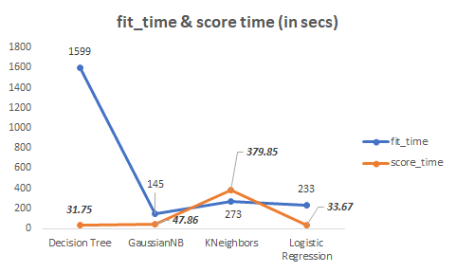
MODELS & PERFORMANCE (Raw Voxels)

Slide 28
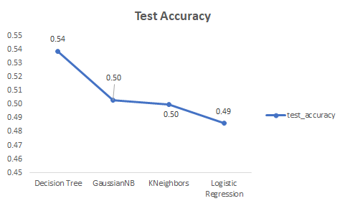
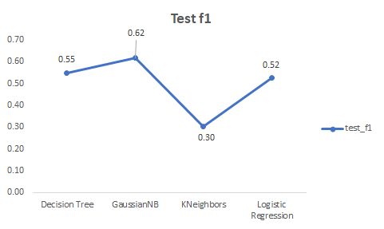
MODELS & PERFORMANCE (Raw Voxels Cont'd)

Slide 29
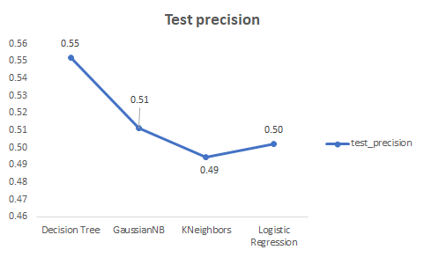
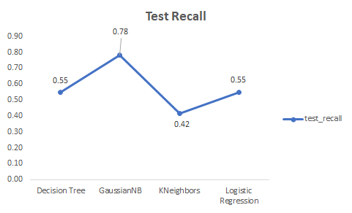
MODELS & PERFORMANCE (Raw Voxels Cont'd)

Slide 30
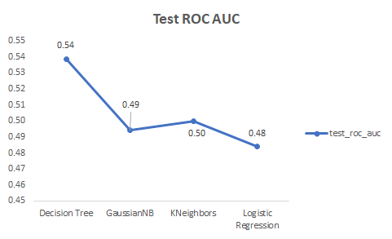
MODELS & PERFORMANCE (Raw Voxels Cont'd)

Slide 31
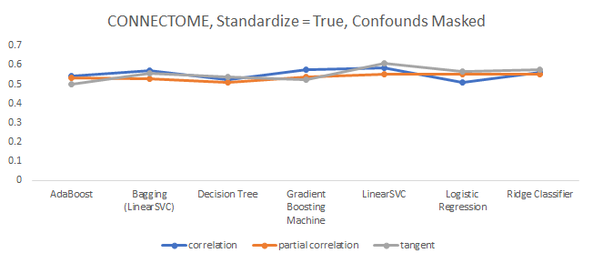
MODELS & PERFORMANCE (Connectomes)

Slide 32
MODELS & PERFORMANCE (Cont'd)
Convolutional Neural Net
Long-Short Term Memory
Recurrent Neural Net
4 Hidden Layers
Operating on Raw Voxels
5 fold cross validation
1000 epochs per fold, with early stop
Average Train Accuracy: 100%
Average Validation Accuracy: 53.33%
Operating on Raw Voxels
5 fold cross validation
1000 epochs per fold, with early stop
Average Train Accuracy: ???
Average Validation Accuracy: ???

Slide 33

RESULTS & FUTURE WORK
RESULTS
Based on our approach to feature extraction and model building, we achieved an accuracy of 58% in classifying sleep deprivation
Lessons learnt
The role of confounds in building a classifier couldn't be explained objectively
This is hard
FUTURE WORK
Explore better/other features or methods that may reduce noise, ex. mask off Regions of Interest
More detailed analysis of which Regions of Interest are better correlated to sleep deprivation, ex. ROI related to the Default Mode Network
Investigate the effect of sleep deprivation on global signal
Deep dive into FFT exploration
Advanced PCA
Explore reaction-time in BOLD response

